Slide 1

Instruction Set Architecture
Hardware/Software Interface
Instruction Execution Flow
Assembly Programming

Slide 2

Instruction Set Architecture (ISA)
Compiler: translates to machine instructions
Procedure call
parameter passing
Memory Map
Computer System 설계
Operating System

Slide 3
Instruction Set Architecture (ISA)
Language of the Machine
Operations
  What kinds, how many, etc.
Operands
  How many and where they are
To Software, Instruction set is What
Computer can do. To Hardware, Instruction set is
what needs to be implemented for a computer.
ISA affects performance, complexity, cost, design time, etc.

Slide 4
Software Layers
overview
Programs in high-level languages such as C, C++, FORTRAN, JAVA
high-level language into assembly code by a compiler
Assembly code into machine code by assembler
Machine code read line-by-line by processor
Executable
(binary)
(interface)
for (j = 1; j < 10; j++){
a = a + b
}
Compiler
Register File
Program Counter
ADD R1, R2, R3
SUB R3, R2, R1
Instruction register
ALU
C
ontr
0010100101
0101010101
ol
L
o
Assembler
gic
Memory Address Register
Memory Data Register

Slide 5
Instruction Cycle (execution model)
overview
- Sequential Execution Model
- Program is a sequence of
instructions
- Instructions are atomic
and executed sequentially
- Stored Program Concept
- Program and data both
are stored in memory
- Instructions are fetched
from memory for execution
Instruction Fetch
Instruction Decode
Operand Fetch
Execute
Result Store
Next Instruction

Slide 6
Instruction Cycle (execution model)
overview
Instruction Fetch
Instruction Decode
Instruction Format/Encoding
Addressing Modes
Operand Fetch
Execute
Op-codes and Data Types
Result Store
Addressing Modes
Next Instruction
Instruction Sequencing

Slide 7
Some Issues
overview
Operand Storage
Memory Addressing
Byte Ordering and Alignment
Control Transfer
Encoding – Orthogonal subfields
Example – MIPS
  RISC (Reduced Instruction Set Computer)
    Simple and Parallel Decoding
    Predictable Fixed Time

Slide 8
Instruction Set Definition (programming model)
Objects = architected entities
  Registers
    General purpose
    Special purpose (e.g. program counter, condition code, stack pointer)
  Memory locations
    Linear address space: 0, 1, 2, … , 2^{s}-1
    machine state = bit pattern in registers and memory
Operations = instruction types
  Data operation (ALU)
    Arithmetic
    Logical
  Data transfer
    Move (from register to register)
    Load (from memory location to register)
    Store (from register to memory location)
  Instruction sequencing (Control)
    Branch (conditional)
    Jump (unconditional)

Slide 9
Operand Storage
Faster access with little overhead in specification and access
  Stack
  0-address format
  No specification overhead – high code density
  Accumulator
  1-address format
  little hardware but high memory traffic
  Registers
  2/3 address format
  more flexible than the above two
  Memory
  2/3 address format
  most flexible but slow

Slide 10
Operand Addressing
Specify where to find operand
  Direct
  memory location or register name for data
  Indirect
  memory location/register name for address
  Relative
  reference point of the address
  Indexed
  distance from the reference point
  Immediate
  data value itself rather than the address

Slide 11
MIPS Assembly Language Notation
Generic
  op x, y, z # x <-- y op z
Addition
  add a, b, c # a <-- b + c
  addi a, a, 10 # a <-- a + 10
Subtraction
  sub a, b, c # a <-- b - c
  subi a, b, 4 # a <-- b - 4
e.g. f = (g + h) - (i + j)
  add t0, g, h # t0 <-- g + h
  add t1, i, j # t1 <-- i + j
  sub f, t0, t1 # f <-- t0 - t1

Slide 12
Registers and Memory (MIPS)
Arithmetic instruction’s operands must be in registers,
— only 32 (general-purpose) registers provided
    $0 hardwired to 0
Compiler associates variables with registers
What about programs with lots of variables (“spill”)
Memory
Typically 512 MB - 2 GB
Registers
Typically 32

Slide 13
Instructions
Load and store instructions
  Example:
  C code: A[12] = h + A[8];
  MIPS code: lw $t0, 32($s3)
  add $t0, $s2, $t0
  sw $t0, 48($s3)
Store word has destination last
Remember arithmetic operands are registers, not memory!
Can’t write: add 48($s3), $s2, 32($s3)
Load-Store Architecture

Slide 14
Memory Organization
Viewed as a large, single-dimension array, with an address.
A memory address is an index into the array
"Byte addressing" means that the index points to a byte of memory.
0
8 bits of data
1
8 bits of data
2
8 bits of data
3
8 bits of data
4
8 bits of data
5
8 bits of data
6
8 bits of data
...

Slide 15
Memory Organization
Bytes are nice, but most data items use larger "words"
For MIPS, a word is 32 bits or 4 bytes.
2³² bytes with byte addresses from 0 to 2³²-1
2³⁰ words with byte addresses 0, 4, 8, ... 2³²-4
Words are aligned
what are the least 2 significant bits of a word address?
0
32 bits of data
4
32 bits of data
Registers hold 32 bits of data
8
32 bits of data
12
32 bits of data
...

Slide 16
Byte Ordering and Alignment
Byte Ordering
  Big Endian – MSB at address ending with 00
  Motorola, Sparc, MIPS, etc.
  Little Endian – MSB at address ending with 11
  Intel, Compaq
  e.g.
  Byte Addr. data
  4 0x00 32-bit word at address 4:
  5 0x56 0x0056121F if Big Endian
  6 0x12 0x1F125600 if Little Endian
  7 0x1F
  8 0x34

Slide 17
Alignment
Natural Boundary: address mod size (in bytes) = 0
e.g. aligned word
addr 3 4 5 6 7
bytes b0 b1 b2 b3 b4
b1 – b4 is an aligned word
b0 – b3 is a unaligned word
Either software guarantees aligned accesses only or
Hardware aligns data access. If misaligned word access happens,
Access memory twice to align proper bytes in a word.

Slide 18
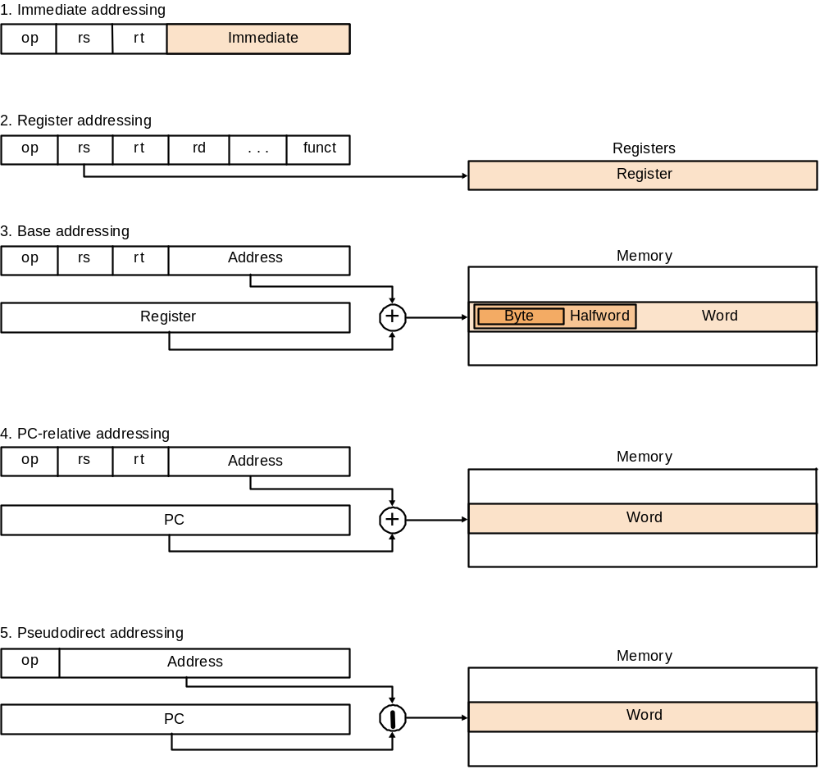
MIPS Addressing Modes

Slide 19
Memory Operations - Loads
Loading data from memory
  R6 <-- mem[0x14]
  Assume &A = 0x14
Program Counter
reg 0
reg 1
reg 2
reg 3
reg 4
reg 5
reg 6
0x00000004
4 bytes wide
Instruction register
0x00 addi R5, R0, 0x14
0x04 l w R6, 0(R5)
0x08
0x0C
0x10
0x14 0x12345678
lw R6,R5
0x00000014
0x12345678
control
logic
Memory Address Register
0x00000014
0x12345678
from memory

Slide 20
Memory Operations - Stores
Storing data to memory
  A := 200
    assume &A = 0x18
  mem[0x18] <-- 200
Program Counter
reg 0
reg 1
reg 2
reg 3
reg 4
reg 5
reg 6
4 bytes wide
Instruction register
0x00 addi R5, R0, 0x18
0x04 addi R6, R0, 200
0x08 sw R6, 0( R5)
0x0C
0x10
0x14 0x12345678
0x18
0x20
control
logic
Memory Address Register
from memory

Slide 21
Instruction Format (Machine Language)
add R8, R17, R18
  is stored in binary format as
    00000010 00110010 01000000 00100000
  MIPS lays out instructions into “fields”
  op operation of the instruction
  rs first register source operand
  rt second register source operand
  rd register destination operand
  shamt shift amount
  funct function (select type of operation)
    add = 32₁₀
    sub = 34₁₀
31 26 25 21 20 16 15 11 10 6 5 0
000000 10001 10010 01000 00000 100000
op rs rt rd shamt funct

Slide 22
Constants
Small constants are used quite frequently (50% of operands)
e.g., A = A + 5;
B = B + 1;
C = C - 18;
Solutions? Why not?
  put 'typical constants' in memory and load them.
  create hard-wired registers (like $zero) for constants like 0.
MIPS Instructions:
addi $29, $29, 4
slti $8, $18, 10
andi $29, $29, 6
ori $29, $29, 4
How do we make this work?

Slide 23
MIPS Instruction Formats
N
a
me
F
iel
d
s
C
o
m
m
e
nt
s
F
i
e
l
d
Si
ze
6
bi
ts
5
bi
ts
5
bi
ts
5
bi
ts
5
bi
ts
6
b
i
t
s
A
l
l M
I
P
S
i
n
s
t
r
u
c
t
i
o
n
s
3
2
bi
ts
R
-f
or
m
at
o
p
rs
rt
rd
s
h
mt
f
un
c
t
Ar
i
th
me
ti
c
instru
c
ti
o
n
f
or
m
at
I
-f
or
m
at
o
p
rs
rt
a
d
dr
e
ss
/
i
m
m
ed
iat
e
Transfer (load/store), branch,
immediate format
J-
f
o
r
m
at
o
p
tar
ge
t a
d
dr
e
ss
J
u
mp
instr
u
cti
o
n
f
or
m
at

Slide 24
Control (Instruction Sequencing)
Decision making instructions
  alter the control flow,
  i.e., change the "next" instruction to be executed
Instructions:
  bne $t4,$t5,Label Next instruction is at Label if $t4 ≠ $t5
  beq $t4,$t5,Label Next instruction is at Label if $t4 = $t5
  j Label Next instruction is at Label
Formats:
Addresses are not 32 bits
— How do we handle this with load and store instructions?
op rs rt 16 bit address
op 26 bit address

Slide 25
Addresses in Branches
Could specify a register (like lw and sw) and add it to address
  use Instruction Address Register (PC = program counter)
    Instructions:
  jr $ra (pc)= ($ra): return
  jal Label save (pc)+4 at $ra = $31 and (pc) = label: call
  most branches are local (principle of locality)
Jump instructions just use high order bits of PC
  address boundaries of 256 MB
  Note: shift by 2-bit for branch and jump target addresses

Slide 26
MIPS Machine Language
N
am
e
F
orm
at
E
x
mp
a
le
C
o
mm
en
t
s
6b
it
s
5
b
ts
i
5
b
ts
i
5
b
ts
i
5
b
ts
i
6b
it
s
a
d
d
R
0
2
3
1
0
3
2
a
d
d $
1,
$
2,
$3
s
u
b
R
0
2
3
1
0
3
4
s
u
b
$
1,
$
2,
$3
a
d
d
i
I
8
2
1
1
0
0
a
d
d
i
$
1,
$
2,
1
0
0
a
d
du
R
0
2
3
1
0
3
5
s
u
b
u $
1,
$
2,
$
3
a
n
d
R
0
2
3
1
0
3
6
a
n
d $
1,
$
2,
$
3
o
r
R
0
2
3
1
0
3
7
o
r
$
1
,
$
2,
$
3
l
w
I
3
5
2
1
1
0
0
l
w $
1,
1
0
0
(
$
2
)
s
w
I
4
3
2
1
1
0
0
s
w $1
,
10
0
(
$
2
)
beq
I
4
1
2
25
beq
$1
, $2
,
10
0
j
J
2
25
0
0
j
1
0
0
0
0

Slide 27
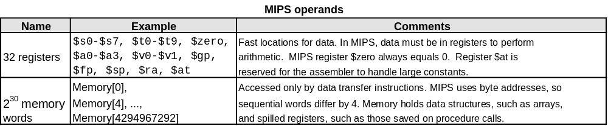
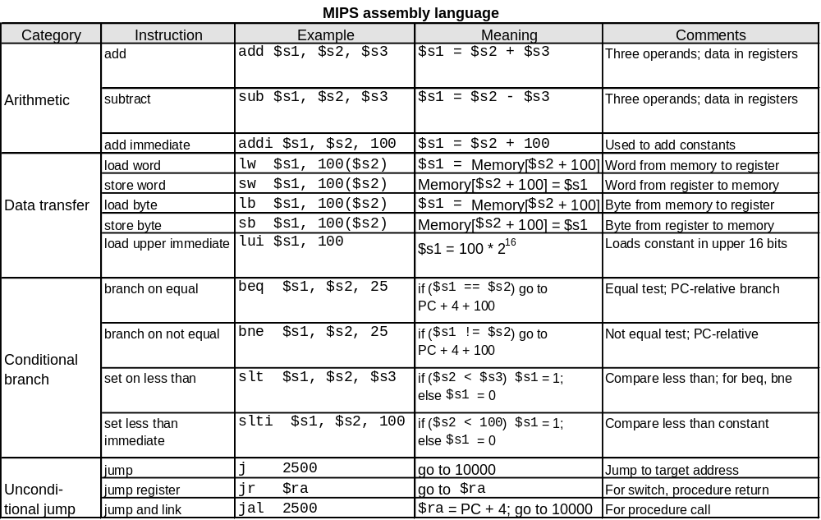
Summary of MIPS ISA

Slide 28
Alternative Architectures
Design alternative:
  provide more powerful operations
  goal is to reduce number of instructions executed
  danger is a slower cycle time and/or a higher CPI
Sometimes referred to as “RISC vs. CISC”
  virtually all new instruction sets since 1982 have been RISC
  VAX: minimize code size, make assembly language easy
  instructions from 1 to 54 bytes long!
CISC - Intel x86

Slide 29
Intel 80x86 (IA-32)
1978: The Intel 8086 is announced (16 bit architecture)
1980: The 8087 floating point coprocessor is added
1982: The 80286 increases address space to 24 bits, +instructions
1985: The 80386 extends to 32 bits, new addressing modes
1989-1995: The 80486, Pentium, Pentium Pro add a few instructions
(mostly designed for higher performance)
1997: MMX is added (Pentium II)
1999: Pentium III (Katmai) more MMX type instructions added
“This history illustrates the impact of the “golden handcuffs” of compatibility
“adding new features as someone might add clothing to a packed bag”
“an architecture that is difficult to explain and impossible to love”

Slide 30
A Dominant Architecture: 80x86 (IA-32)
Complexity:
  Instructions from 1 to 17 bytes long
  one operand must act as both a source and destination
  one operand can come from memory
  complex addressing modes
  e.g., “base or scaled index with 8 or 32 bit displacement”
Saving grace:
  the most frequently used instructions are not too difficult to build
  compilers avoid the portions of the architecture that are slow
CNCE240 Computer System: assembly language programming

Slide 31
A Dominant Architecture: ARM
About 5 billion units in 3 years (2005 ~ 2007)
Dominating architecture in embedded processor core; not much different from the MIPS.
  16 registers – only 4-bits for operand specification
  More addressing modes
  No separate program counter
  16-bit mode (Thumb)
  See the posted article on ARM ISA
  With 64-bit v8 ISA, it now looks more or less same with MIPS:
  32 registers and program counter

Slide 32
INSTRUCTION SET ARCHITECTURE
General Consensus
Load/Store architecture
Simple memory addressing
Limited control transfer scope
Simple procedure call interface
Encoding – orthogonal subfields
Little side effects from keeping program status

Slide 33
RISC vs CISC
RISC Factor: (CPI⋅I)_{vax} /(CPI⋅I)_{MIPS,} D. Bhandarkar and D.W. Clark
CPI: cycles per instruction
I: instruction count (path length)
Benchmark I_{MIPS}/I_{vax} CPI_{MIPS} CPI_{vax} RISC Factor
Spice2g6 2.5 1.8 8.0 1.1
Matrix300 2.4 3.0 13.8 1.9
Nasa7 2.1 3.0 15.0 2.4
Fpppp 3.9 1.5 15.2 2.7
Tomcatv 2.9 2.1 8.2 2.9
Dudoc 2.7 1.7 13.2 3.0
Eqntott 1.1 1.3 4.4 3.3
Li 1.6 1.1 6.5 3.7

